Slide 1
The Effects of Nutrition
Presented by:
Date:

Slide 2
Introduction
Good nutrition promotes health outcomes.
The body requires specific amounts of varying nutritional elements regularly.
Poor nutrition affects the normal functions of the body.
Prolonged malnutrition leads to weight loss, disease, and even death (Bekele et al., 2019).
Poverty, psychological illnesses, and lack of health education are common causes of poor nutrition.
Notes:
Poor nutrition is a major issue in contemporary society. It is a leading cause of illnesses and mortality within various age groups. Poor nutrition is particularly a major challenge for children in the developing stages because it influences physical and mental growth rates. Health is dependent on the body’s access to specific nutritional elements; hence, there is a need to ensure that the body accesses them. This can be achieved by eating a variety of foods and observing the recommended volumes. It can also be realized by ensuring that all nutritional requirements of the body are met.
Good nutrition enhances health outcomes.
Nutrition is a function of the elements in a given food product.
Food with the relevant nutritional elements helps in:
Growth and development of body organs
Enhancing the effectiveness of the immune system.
Energy production for daily activities.
Balancing the chemical functions of the body.

Slide 3
Impacts of Poor Nutrition
Stunted growth, weak bone structure.
Tissue and organ damage.
Poor immunity.
Various deficiencies (Khandelwal et al., 2018).
Inability to work.
Possible death.

Slide 4
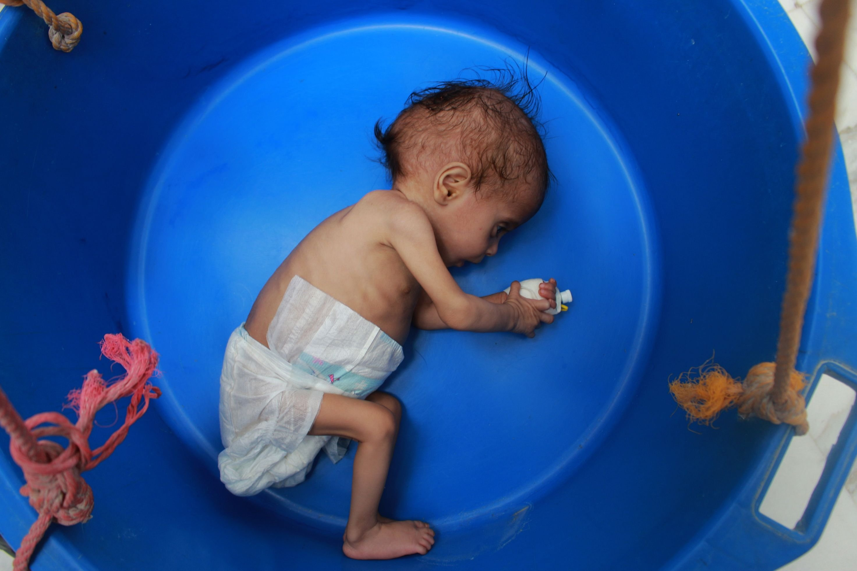
Stunted Growth
Poor nutrition leads to slow growth.
People facing malnutrition have slow body maturation.
Children are characterized by shortness.
Body weight is relatively low.
BMI tests highlight the need for better nutrition.
149 million children below five years are facing malnutrition today (WHO, 2021).
Image source (Daily Sabah, 2020)
Notes:
The basal metabolism influences nutritional requirements. Poor nutrition is often caused by the lack of information on the amounts of nutrients needed for basic body functions. The physical activities that an individual engages in regularly also influence the nutritional requirements (Bekele et al., 2019). Similarly, physiological factors like pregnancy, age, and maturation, among others, impact an individual’s dietary needs.

Slide 5
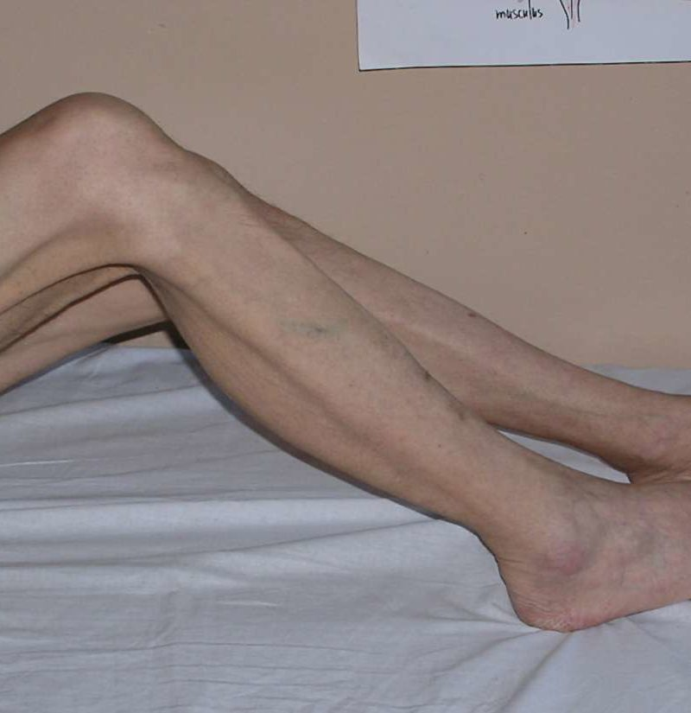
Tissue Damage
The lack of sufficient food causes tissue damage.
Nutritional elements that facilitate tissue growth are required.
Shrinking tissues cause problems in organs.
Functions of organs like the brain and heart are affected.
It causes conditions that may require long-term management due to organ damage.
Image source: Muscle atrophy (Medical News Today, 2021).

Slide 6
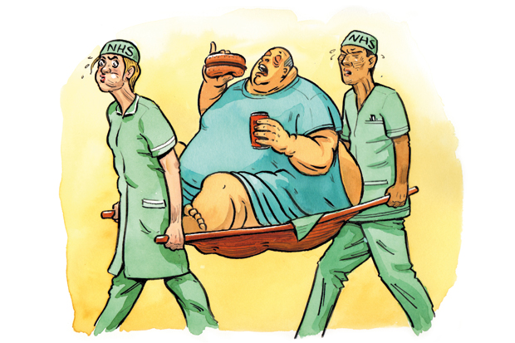
Obesity
Poor nutrition may also result in weight problems.
Obesity is a prevailing issue in society globally.
19% of young people and 40% of adults are facing obesity (CDC, 2021).
Obesity is closely linked to consuming unhealthy foods.
Junk foods are addictive, and they provide more carbohydrates and fats.
Leads to high levels of bad cholesterol.
Predisposes individuals to various chronic disorders.
Image source (American Society for Nutrition, 2016)

Slide 7
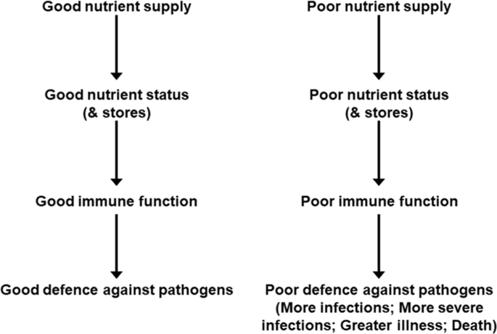
Poor Immunity
Poor diet and nutrition lead to low immunity.
Lack of vitamins and minerals influences lower immune response rates.
May trigger autoimmune disorders.
Immune cells are disabled when there is a low supply of relevant nutrients.
Some vital minerals and vitamins trigger antibody production.
Image source (Calder, 2021).
Notes:
There is a wide range of conditions influenced by a deficiency in nutrients and over-consumption of some nutrients. The highlighted conditions fall under different categories, but they are all linked to the types of foods and their nutritional value that individuals consume (Firth et al., 2020). It is necessary to observe the nutritional value of different foods to ensure that one is accessing the appropriate amounts of vital elements to promote positive health outcomes.

Slide 8
Low Energy and Death
Mass death of cells due to lack of energy.
Inability to work.
Movement is limited for the individual.
Numerous infections due to a weakened immune system.
Potential death from malnutrition and infections.
Notes:
Many conditions are linked to poor nutrition, and understanding their symptoms helps in early intervention for health promotion. People should feed based on their basal metabolic and energy requirements based on physical activities and physiological factors (Khandelwal et al., 2018). There should be a focus on increasing the variety of foods consumed regularly to ensure that all the nutritional elements are acquired. Most importantly, people should be compelled to drink enough water daily.

Slide 9
Conclusion
Food and water are required in the appropriate amounts regularly.
Poor nutrition entails failing to consume adequate amounts of either of the vital nutritional elements.
It leads to wasting, stunted growth, poor mental development, and poor immunity.
Various conditions related to poor nutrition are preventable by providing sufficient nutrients.
Responsiveness to nutritional needs reduces the negative impacts of poor nutrition.

Slide 10
References
American Society for Nutrition. (2017, August 18). Obesity is not a disease of sloth and gluttony. https://nutrition.org/obesity-not-disease-sloth-gluttony/
Bekele, A., Wolde-Gebriel, Z., & Kloos, H. (2019). Food, diet, and nutrition. In H. Kloos & Z. A. Zein (Eds.), The ecology of health and disease in Ethiopia (1st ed., pp. 85-102). Routledge.
Calder, P. C. (2021). Nutrition and immunity: Lessons for COVID-19. European Journal of Clinical Nutrition, 75(9), 1309-1318. https://doi.org/10.1038/s41430-021-00949-8
Centers for Disease Control and Prevention. (2021, January 12). Poor nutrition. https://www.cdc.gov/chronicdisease/resources/publications/factsheets/nutrition.htm
Daily Sabah. (2020, October 27). Child malnutrition surges to highest levels ever recorded in war-torn Yemen, UN says. https://www.dailysabah.com/world/mid-east/child-malnutrition-surges-to-highest-levels-ever-recorded-in-war-torn-yemen-un-says
Firth, J., Gangwisch, J. E., Borsini, A., Wootton, R. E., & Mayer, E. A. (2020). Food and mood: How do diet and nutrition affect mental wellbeing? BMJ, m2382. https://doi.org/10.1136/bmj.m2382
Khandelwal, S., Kurpad, A., & Narayan, K. M. (2018). Global non-communicable diseases—The nutrition conundrum. Frontiers in Public Health, 6. https://doi.org/10.3389/fpubh.2018.00009
Eske, J. (2019, May 30). Muscle atrophy: Causes, symptoms, and treatments. Medical News Today. https://www.medicalnewstoday.com/articles/325316
World Health Organization. (2021, June 9). Malnutrition. https://www.who.int/news-room/fact-sheets/detail/malnutrition

Slide 11
WritingElites.net – The Custom Writing Experts
Need an original, high-quality, plagiarism-free presentation like this one?
Order Now

