Slide 1
An Evaluation of Apple Inc.’s Business Strategy
Presented by:
Date:

Slide 2

Introduction
Founded in 1976 by Steve Jobs and Steve Wozniak.
Headquartered in California.
Production of electronics and Computer software
Largest IT company in the world
Popular for iPhone, Mac Books, iPads etc.
Committed to enhancing consumer experience.

Slide 3
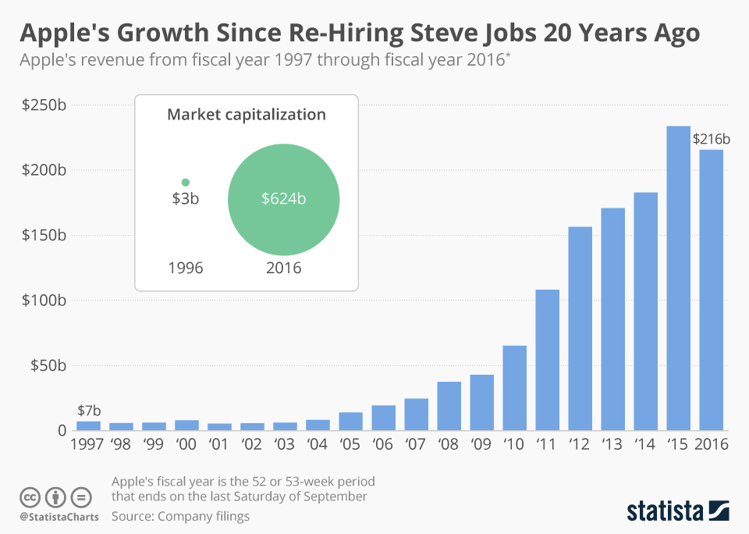
Business Strategies
Cost Leadership
Differentiation of Products
Innovation
Quality Focus
Brand Loyalty and Diversification (Richter)

Slide 4
Cost Leadership
Collaborating with other tech companies.
Reliable global supply chain to reduce cost of production.
Ensuring there is value in the cost based on quality of products.
Providing solutions to consumers for a reasonable cost.
Emphasizing on standardized pricing of products across the world.
Developing a distribution channel that reduces extra cost on products.
Notes:
Apple is a leading company in the tech industry following its focus on the development of products at the most affordable costs. The company collaborates with various multinational entities in the production of high-quality computerized gadgets (Payne 54). The pricing of the products is often based on the cost of production, but they are the most reliable in the market; hence, there is perceived value in the cost.

Slide 5
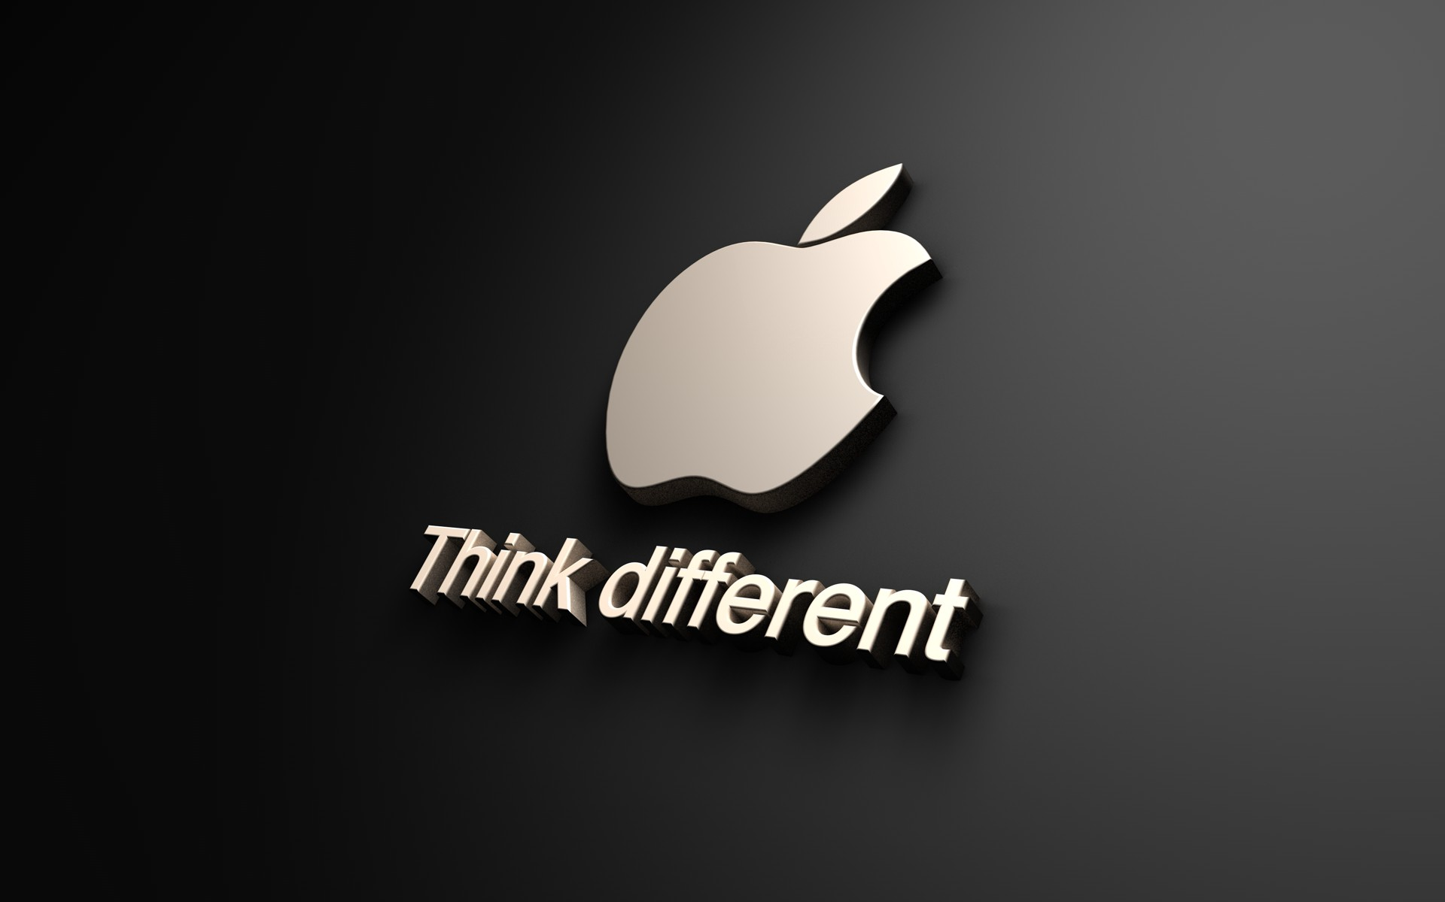
Differentiation of Products
Critical focus on design quality.
Futuristic approaches to solving societal needs in technology.
Unique hardware and software production.
Competitive power generated from new technology.
Providing high-quality user experience through sophisticated programs (Payne 54).
Enhancing value by improving on previous models.

Slide 6
Innovation
Heavy investment on research to enhance creativity.
Developing a highly competent human resource base for innovation.
Creating a culture of risk-taking and creativity in the organization.
Focus on developing new products rapidly.
Improving previous generation products through unique designs and new tech (Tien 26).
Responding to consumer needs through creative solutions.

Slide 7
Quality Focus
Apple focuses on providing the best quality of products.
Brand appeal is contingent on quality of products.
Implementation of Six Sigma strategy for quality enhancement.
Total quality management emphasized by management function.
Hands-on approach to the leadership process (Pooja 2).
Research for continuous improvement of product quality.

Slide 8
Brand Loyalty and Diversification
Progressively enhancing the quality of designs.
Facilitating futuristic features in the electronic devices.
Rapid response to consumer needs.
Developing products that outdo all other brands in the market.
Expansion of product portfolio through innovative technology.
Increasing the emotional attachment of the consumers to the brand and products.

Slide 9
Conclusion
Apple Inc. has developed a holistic business strategy
It focuses on quality enhancement.
Diversification through innovation and creativity.
A critical focus on progressive improvement of the products.
Employing a very competent human resource base.
Investing on research.
Expansion of product portfolio and user experience.
Company is highly competitive in pricing and quality.

Slide 10
Works Cited
Payne, Bronwyn. “Brand Positioning and Its Usefulness for Brand Management: The Case of Apple Inc.” Newcastle Business School Student Journal, vol. 1, no. 1, 12 Apr. 2017, pp. 51–57.
Pooja, B C. “An Organization Study Report of APPLE Inc.” Visvesvaraya Technological University, Belagavi, 2021.
Richter, Felix. “Apple's Growth Since Re-Hiring Steve Jobs 20 Years Ago.” Statista, 21 Dec. 2016, https://www.statista.com/chart/7330/apple-revenue-since-1997/.
Tien, Nguyen Hoang. “International Distribution Policy Comparative Analysis between Samsung and Apple.” International Journal of Research in Marketing Management and Sales , vol. 1, no. 2, 17 June 2019, pp. 24–27.

Slide 11
WritingElites.net – The Custom Writing Experts
Need an Original, High-Quality, Plagiarism-Free Presentation Like This One?
Order Now

